Slide 1
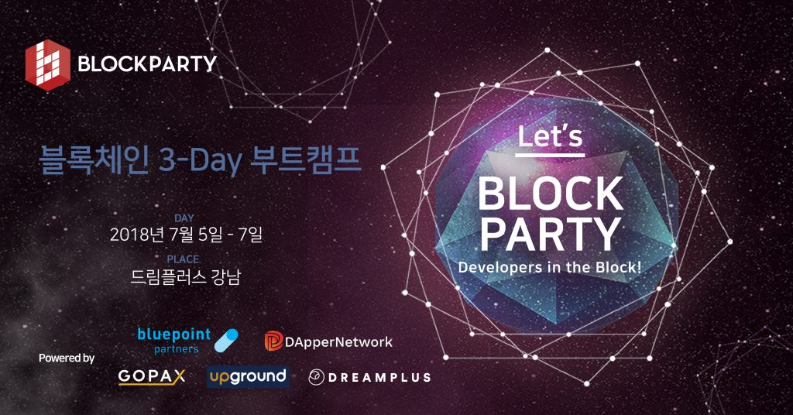

Slide 2

Intro to Ethereum Development
Eric Chung, DApperNetwork Founder
DAPPERNETWORK

Slide 3
Purpose.
1

Slide 4
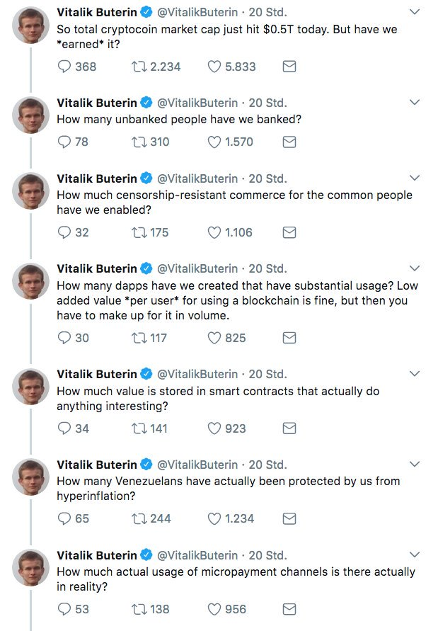

Slide 5
A lot of talk,
not a lot of walk.
PURPOSE

Slide 6
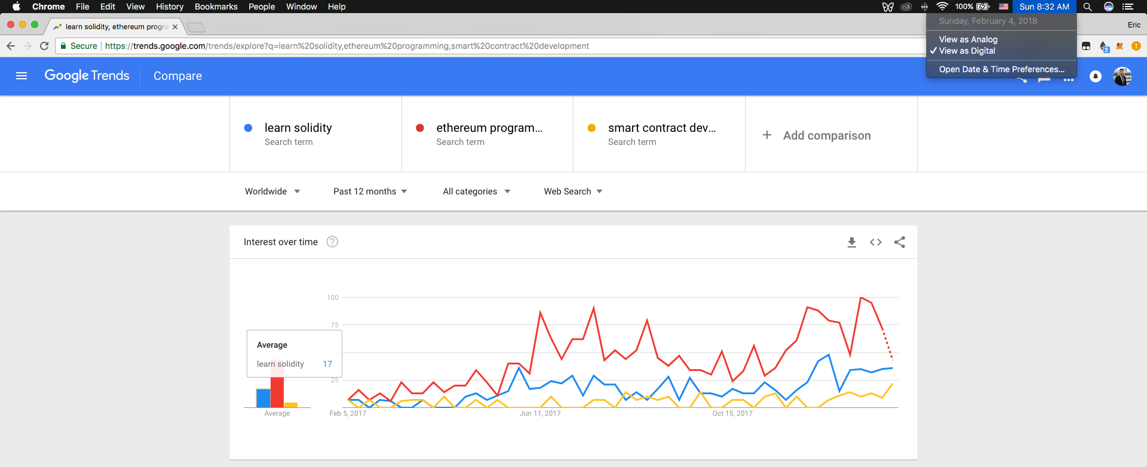

Slide 7
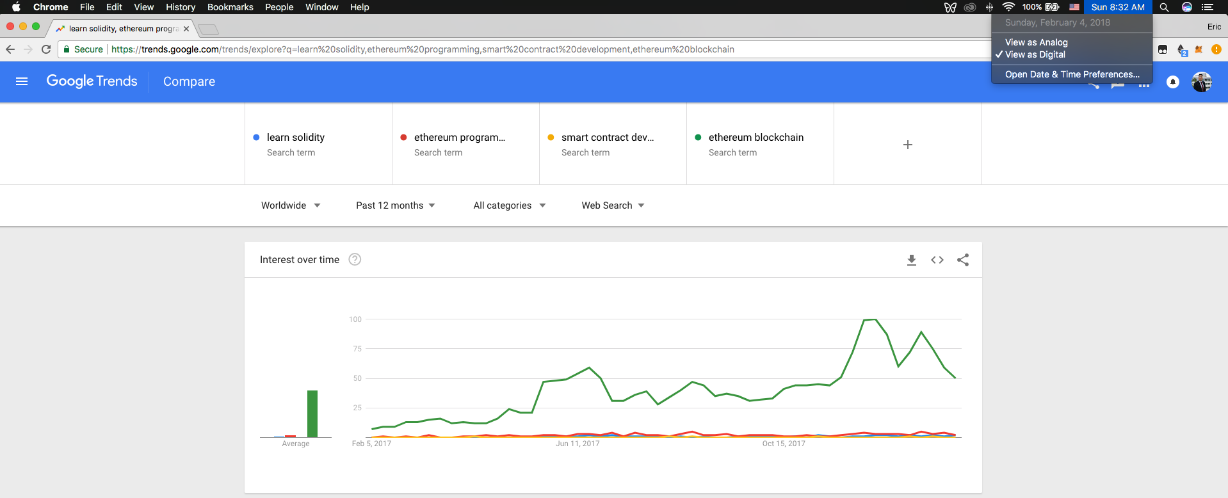

Slide 8
Shortage.
Huge shortage.
STATE OF THINGS

Slide 9
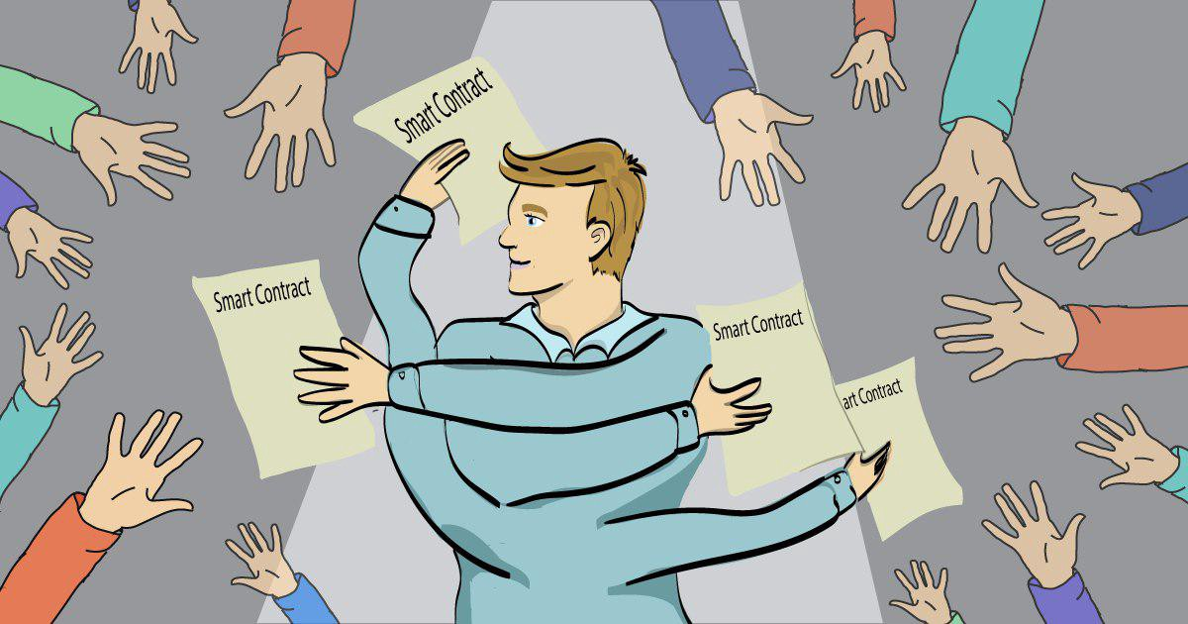

Slide 10


Slide 11
Simple economics.
PURPOSE

Slide 12
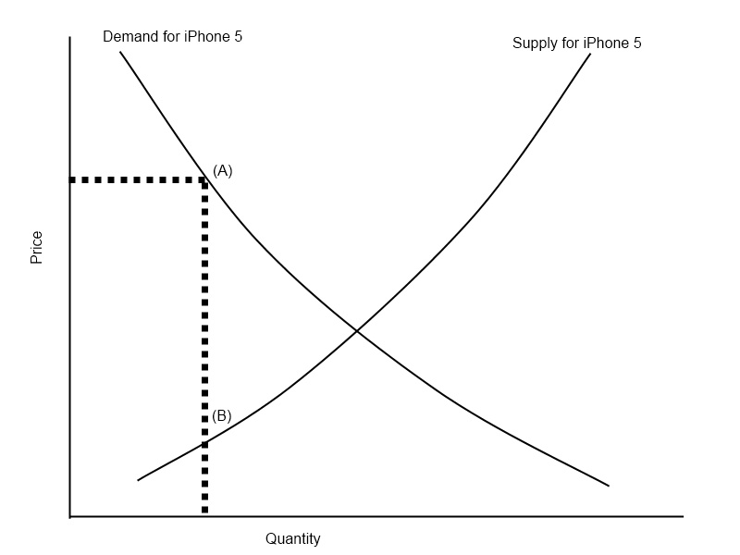
Ethereum developers
Ethereum developers

Slide 13
Still very early.
PURPOSE

Slide 14
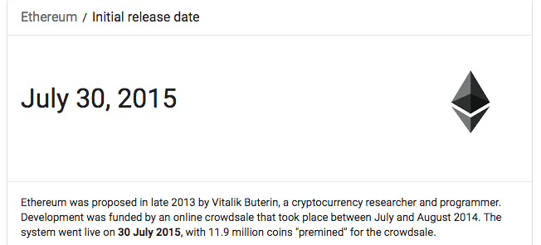

Slide 15
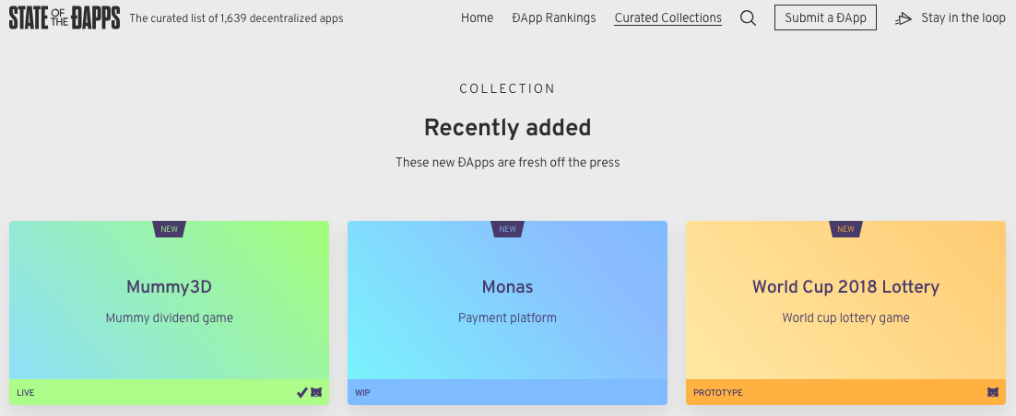
1639 Ethereum DApps currently

Slide 16
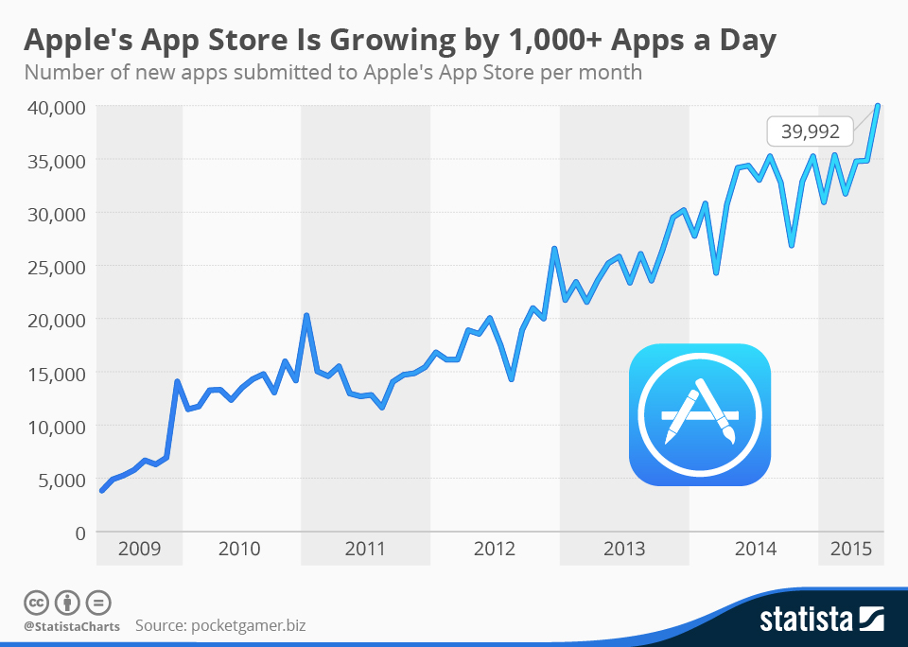

Slide 17
Ingredients.
2

Slide 18
The Blockchain.
Blocks
Hashes
Consensus
Trust
INGREDIENTS

Slide 19
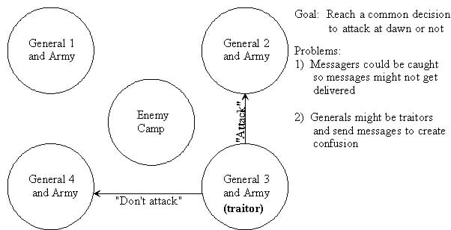

Slide 20
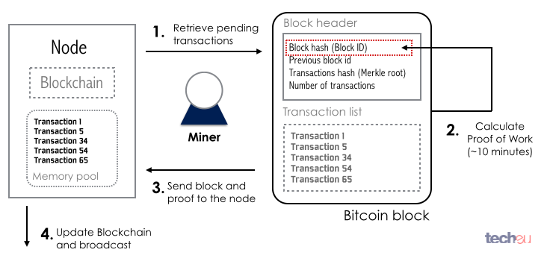

Slide 21
Smart Contracts.
Lineage includes Nick Szabo, colored coins
Turing-completeness
Distributed code vending machines
INGREDIENTS

Slide 22

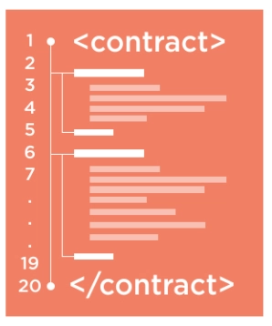

X
Ethereum

Slide 23
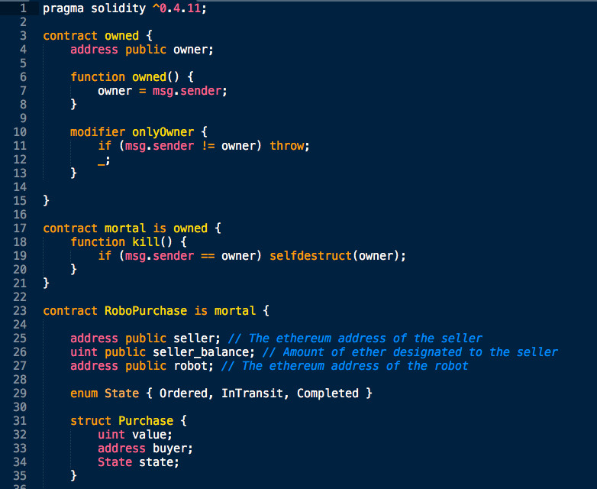

Slide 24
World Computer.
Ethereum Virtual Machine = decentralization
Every single node runs every bit of code to verify output
INGREDIENTS

Slide 25
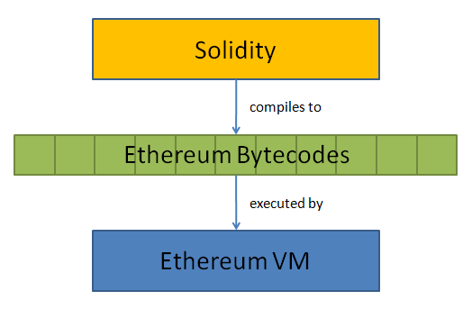

Slide 26
Gas.
Cost of computing resources required to perform an operation
Gas limit = ceiling for operation
Gas price = “pay attention to my transaction”
Gas fees feed miners
INGREDIENTS

Slide 27
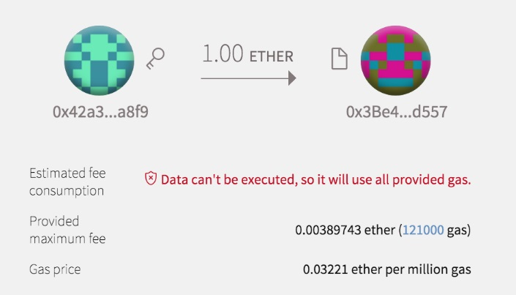

Slide 28
Gas.
Prevents infinite loops and intensive computations
Sloppy code is expensive and unacceptable
Security ALWAYS trumps optimization
INGREDIENTS

Slide 29


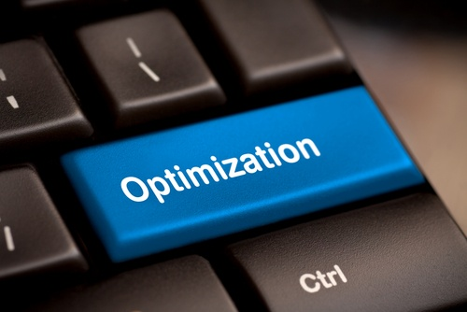

Slide 30
Deployment Tools.
Remix: Browser, fast and easy, good to get feet wet
Truffle: Command line, intermediate level, testing and deploying
INGREDIENTS

Slide 31
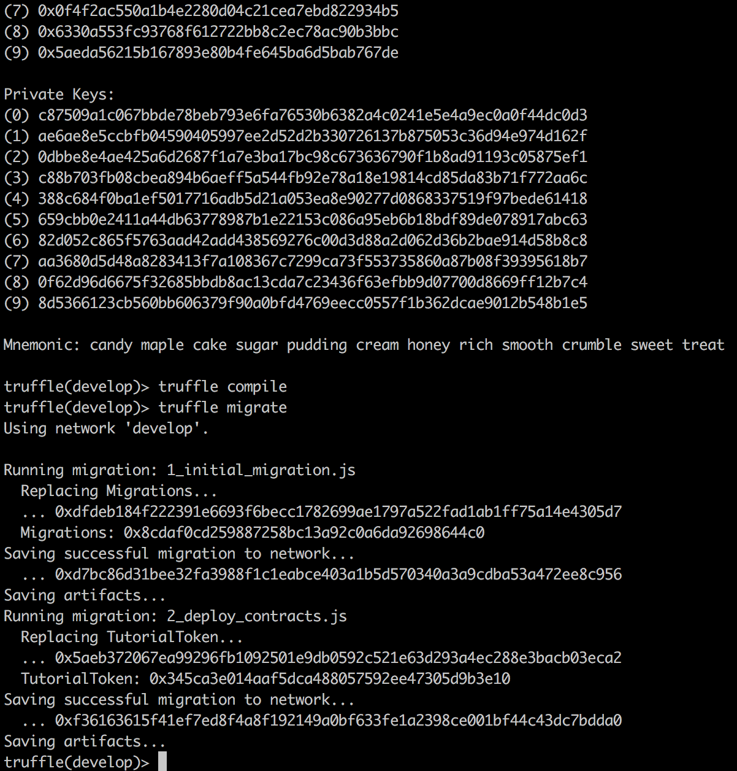
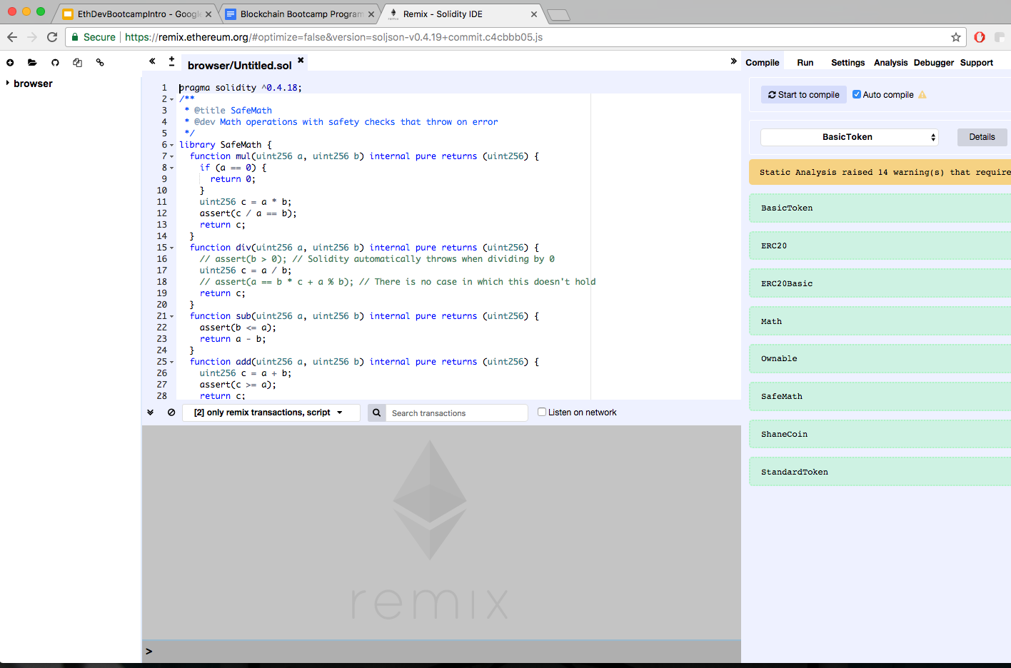

Slide 32
Smart Contract Tools.
Solidity: lingua franca
Web3js: mediator
IPFS: storage
INGREDIENTS

Slide 33
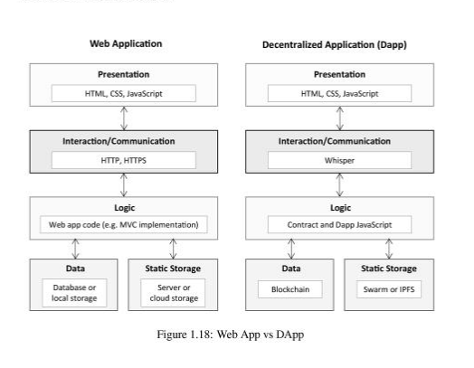

Slide 34
Ancillary Tools.
Metamask: Chrome extension wallet
Etherscan: block explorer
OpenZeppelin: contract templates
Infura: node clusters
IPFS: storage
INGREDIENTS

Slide 35
Other Blockchains.
EOS
Neo
Lisk
INGREDIENTS

Slide 36
DApp.
Over 1k DApps on State of the DApps
Prediction markets, DEX, social networks, curated lists, and more
INGREDIENTS

Slide 37
Themes.
3

Slide 38
Immutability.
Code that is deployed on the blockchain is there FOREVER
No surprises vs no (direct) patching
THEMES

Slide 39
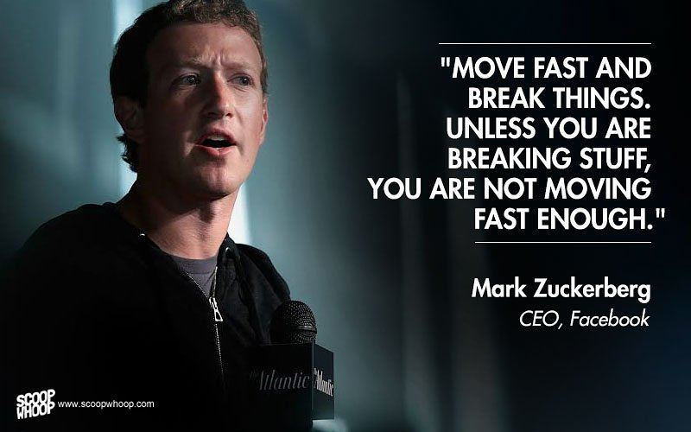

Slide 40
Security.
Move slow fast, don’t break anything
Risk mitigation
“Messing up a website may take a site down for a few minutes, but messing up a [blockchain] transaction may lead to loss of money.”
- Jimmy Song
THEMES

Slide 41
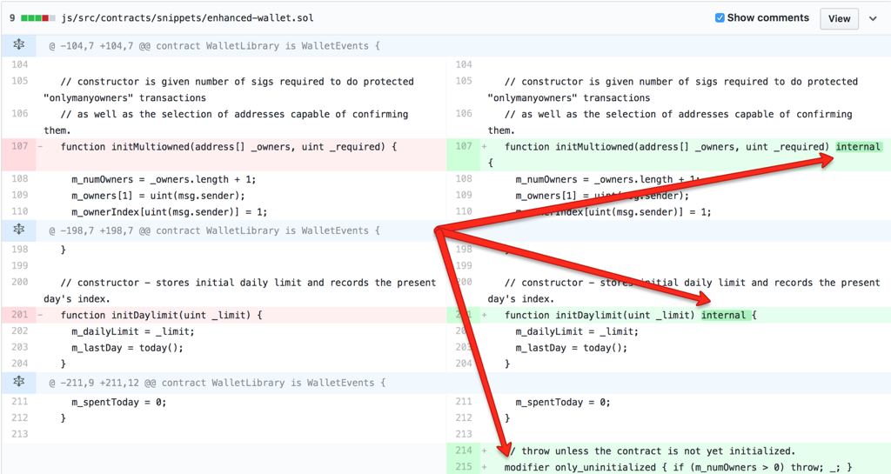
$117,000,000 bug

Slide 42
Transparency.
Honest accountability
Transactions, code, addresses, balances
THEMES

Slide 43
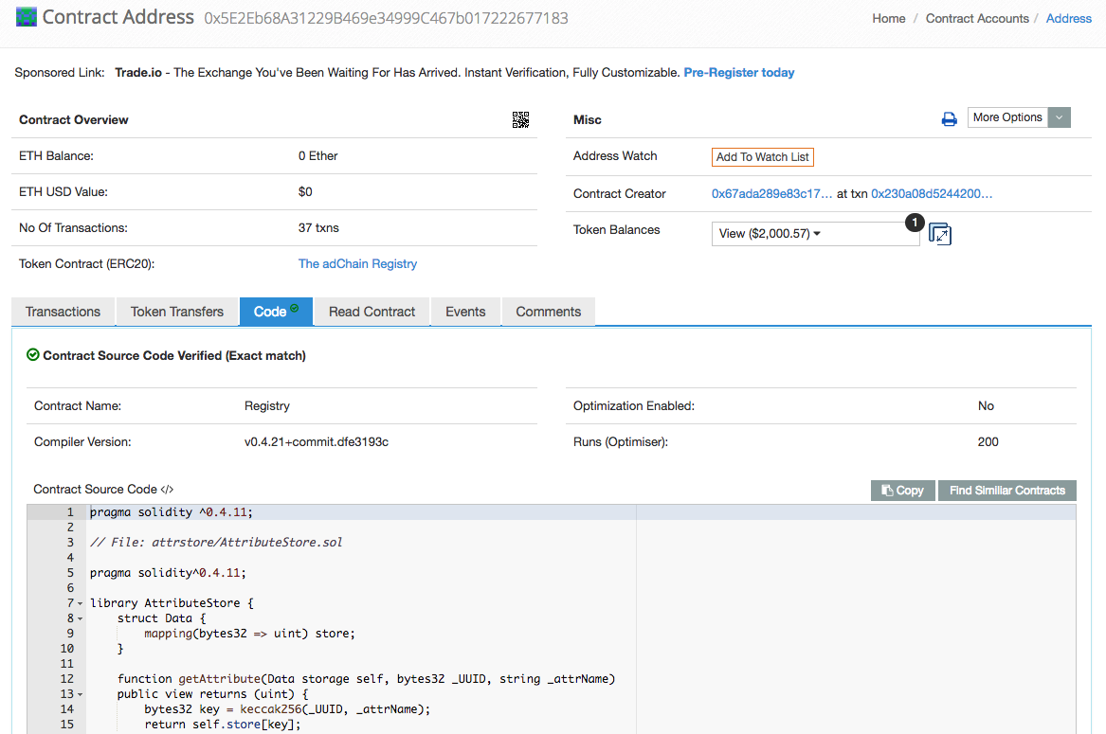

Slide 44
Token Economics.
Programming incentives to guide human behavior
Economic value directly coupled with code
THEMES

Slide 45




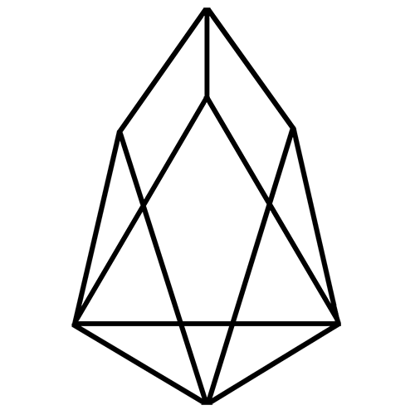

X

Slide 46
Scalability.
Significant bottleneck
Plasma, Raiden, sharding, state channels
THEMES

Slide 47
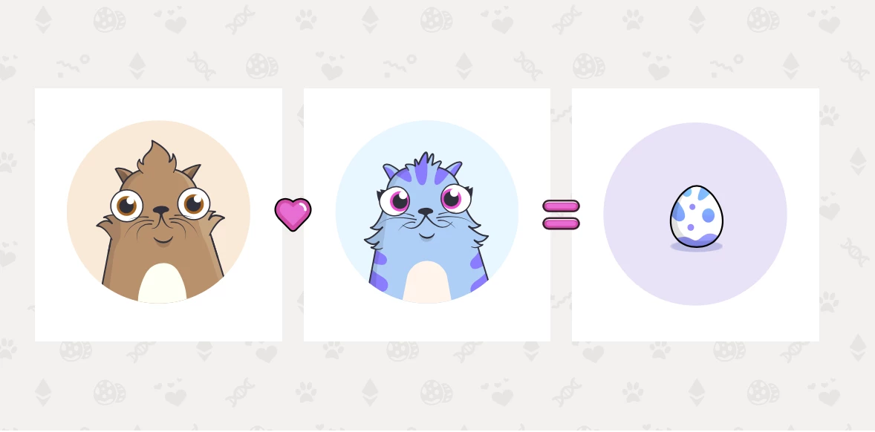

Slide 48
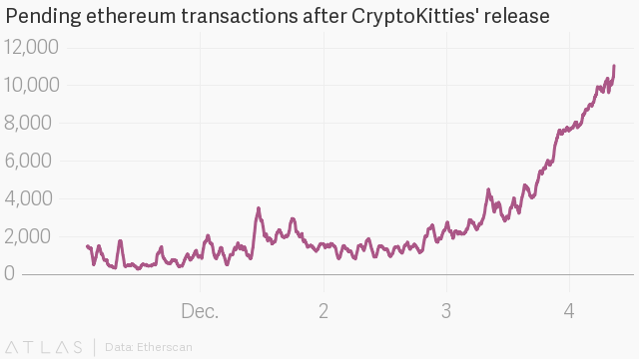

Slide 49
User Experience.
Mass consumer adoption
Private key management, intuitive design, better aesthetics
THEMES

Slide 50


Slide 51
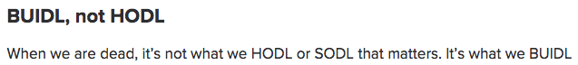

Slide 52
Thanks yall!
Eric Chung, DApperNetwork Founder
DAPPERNETWORK

